Slide 1
Yammer’s Products

Slide 2

Yammer’s sandal: p899.00

Slide 3
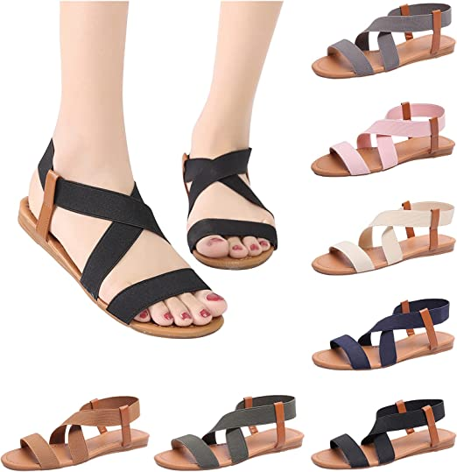
Multi color sandal: P599.00

Slide 4

HOODY: P550.00

Slide 5


Dress
P1,009.00
Dress
P1,100.00

Slide 6

P899.00

Slide 7

P699.00

Slide 8


Jeans P1,999.00
P2,000.00

